Slide 1
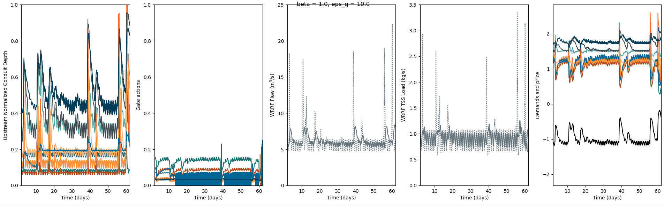
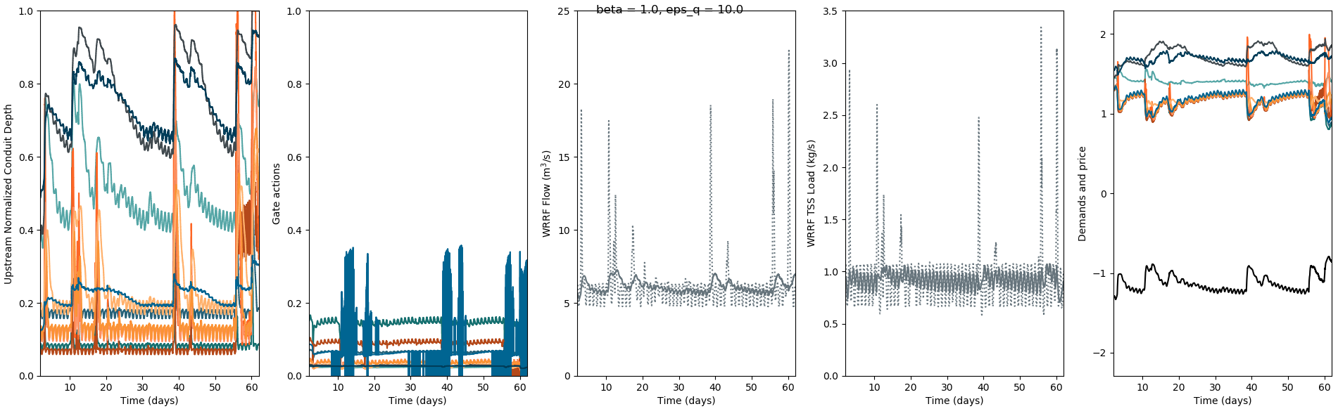
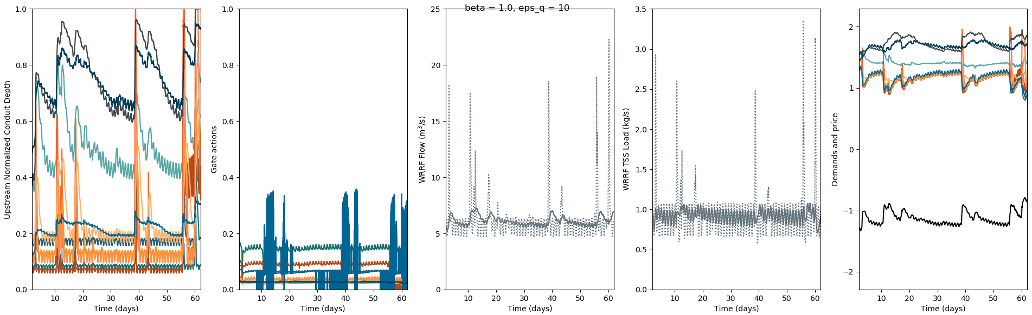
Original.1
test_flow_3
Testing1: betai Hi >= Cbar
test_flow_4
Testing2: e(Hi)-1/e-1 >= Cbar
test_flow_5

Slide 2
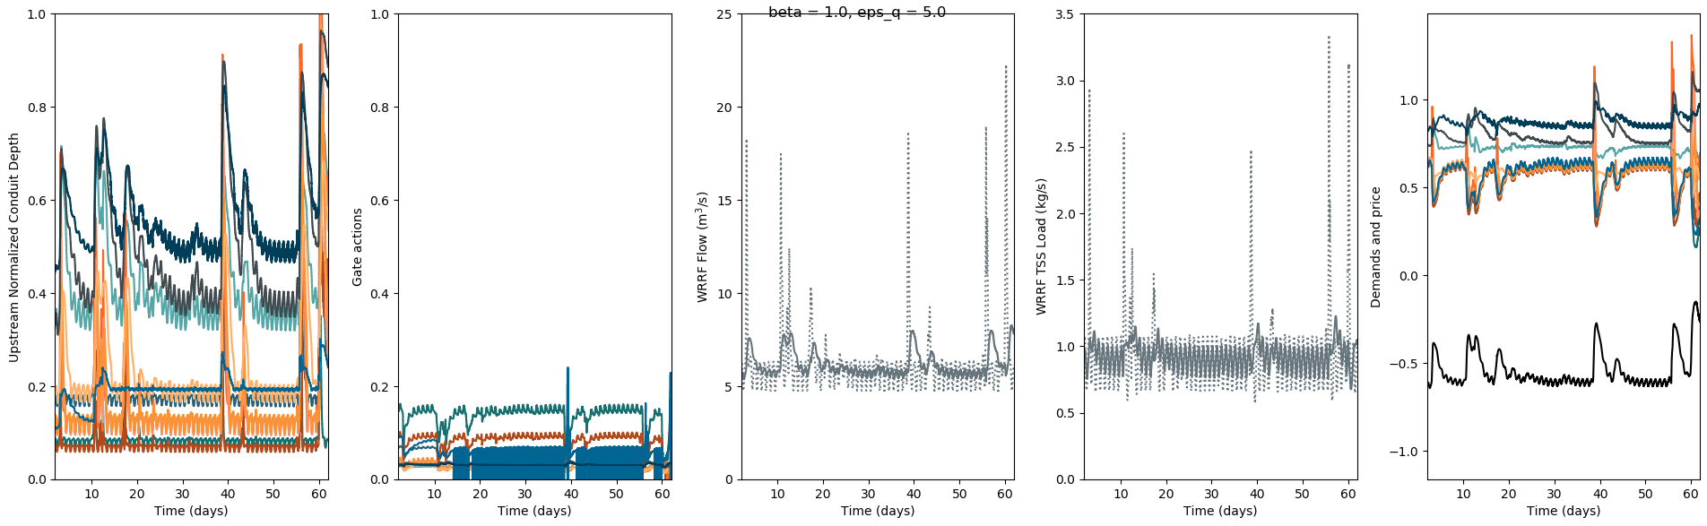
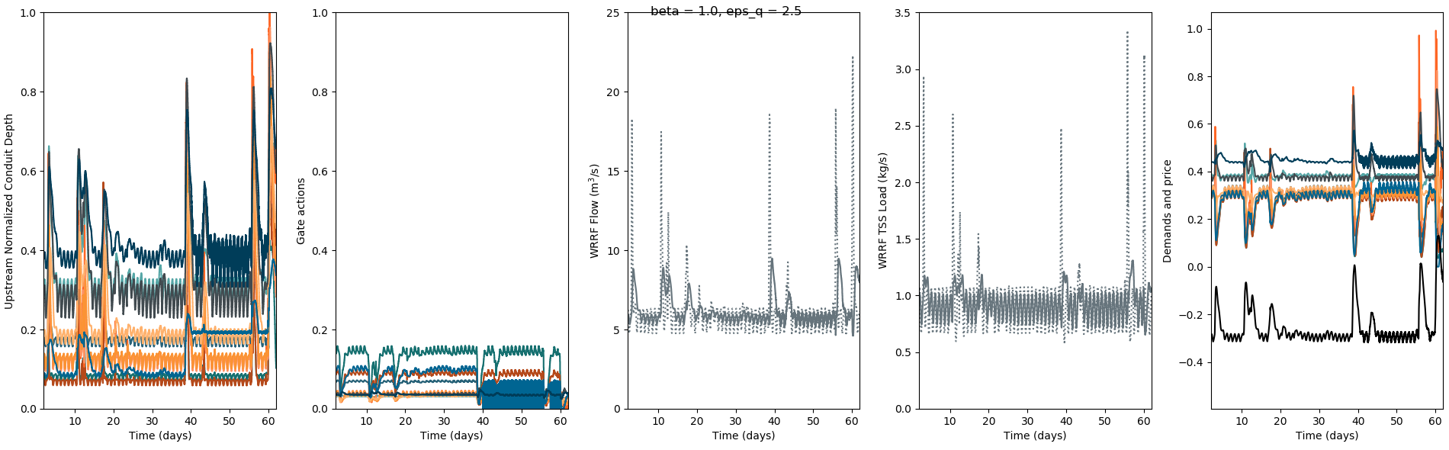
Testing1: betai Hi >= Cbar
test_flow_4

Slide 3

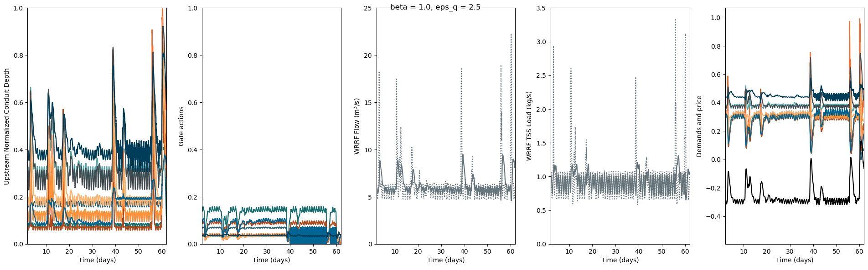
Testing2: e(Hi)-1/e-1 >= Cbar
test_flow_5

Slide 4
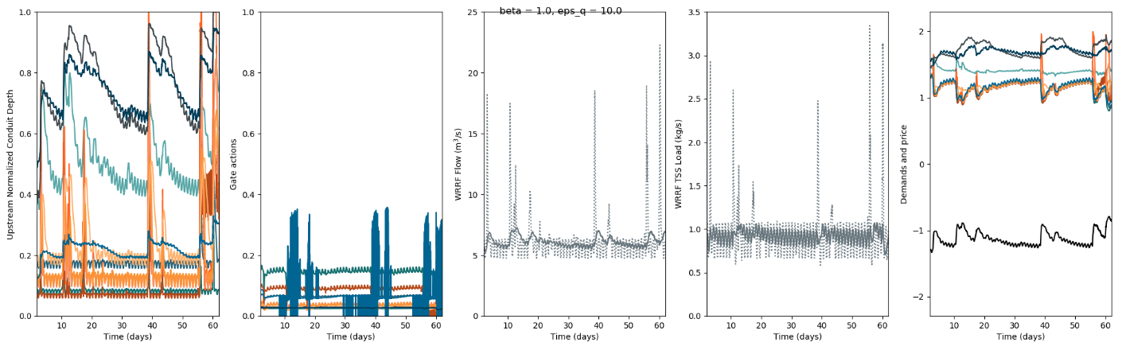
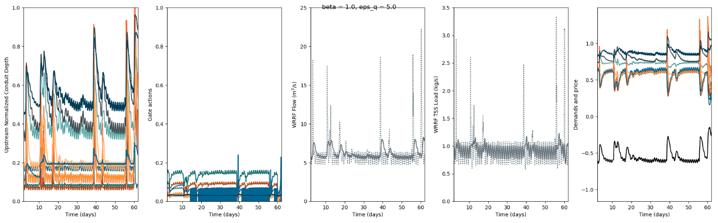

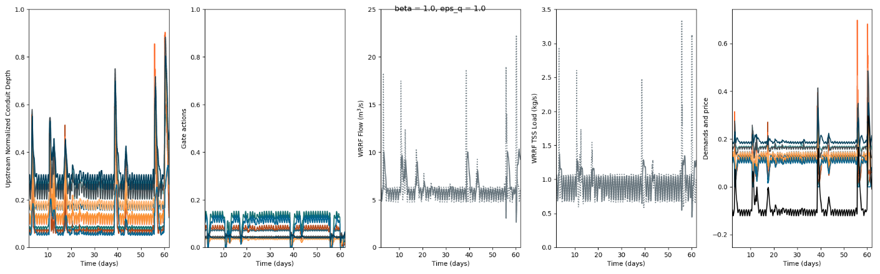
Testing: e(N*Hi)-1/e(N)-1 >= Cbar
test_flow_6
N = 1
eps_q = 10
eps_q = 5
eps_q = 2.5
eps_q = 1

Slide 5
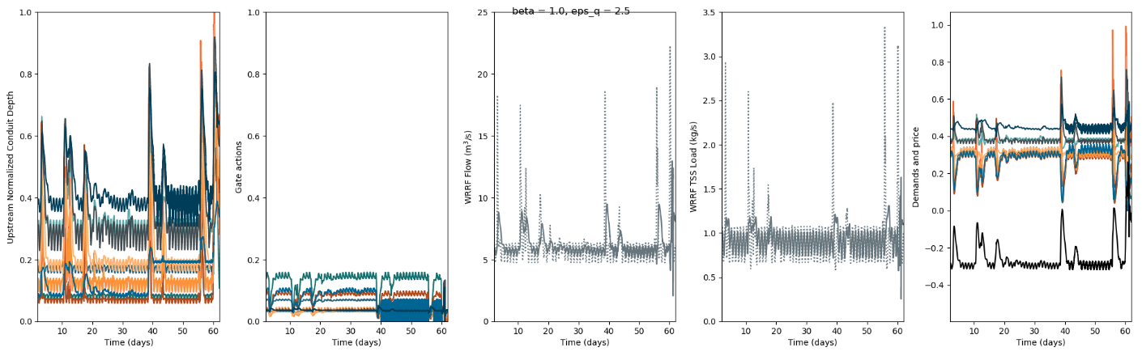
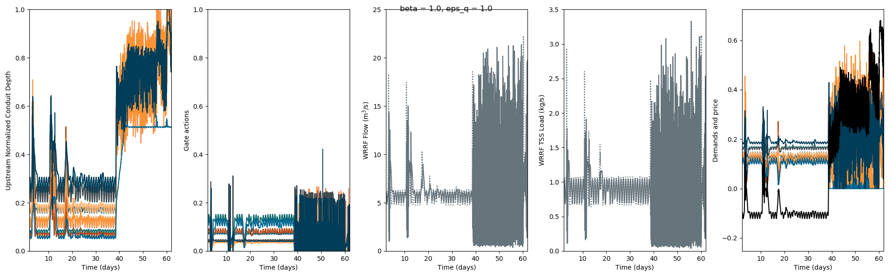
Testing: e(N*Hi)-1/e(N)-1 >= Cbar
test_flow_6
N = 5
eps_q = 10
eps_q = 5
eps_q = 2.5
eps_q = 1

Slide 6
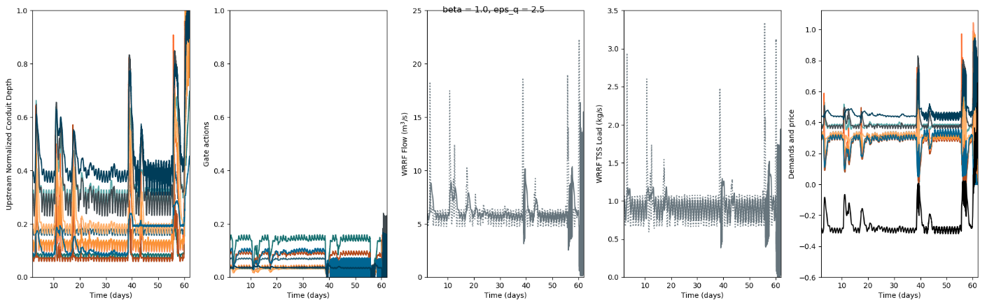
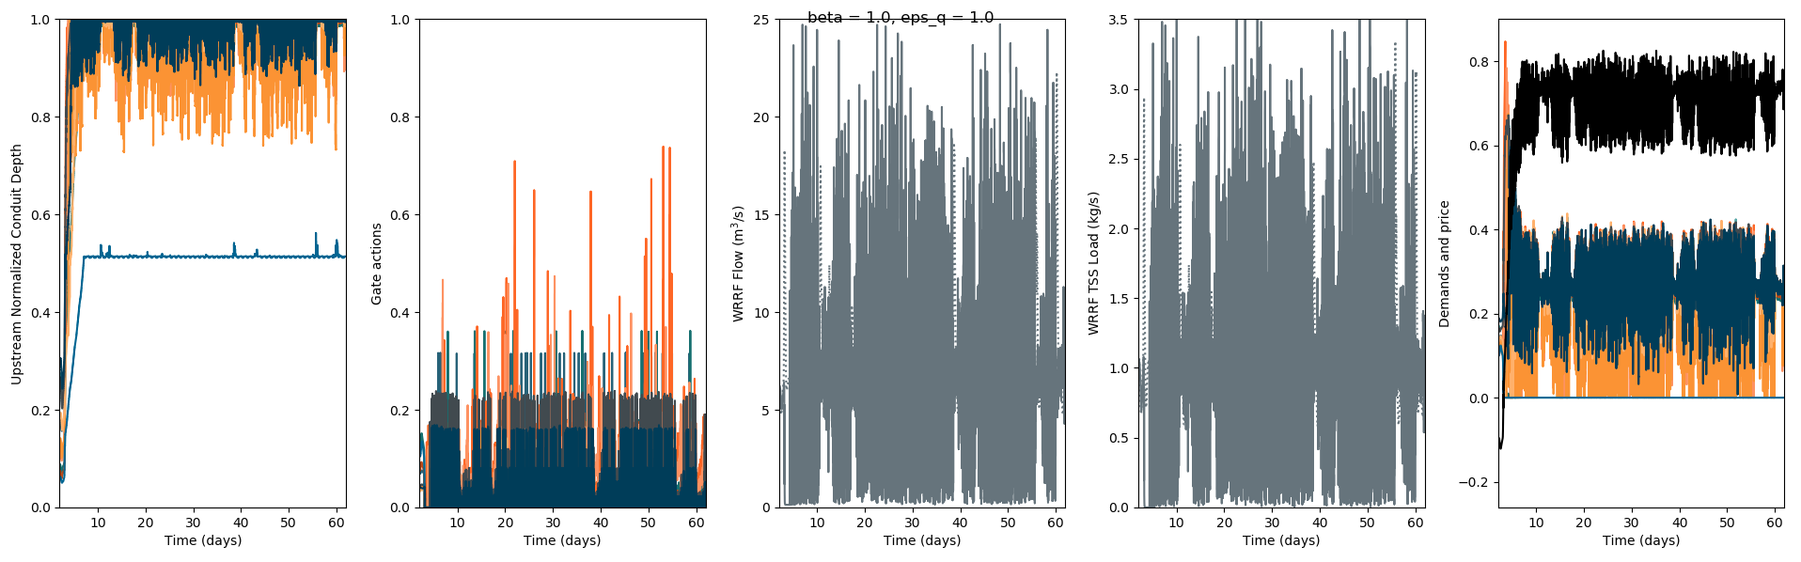
Testing: e(N*Hi)-1/e(N)-1 >= Cbar
test_flow_6
N = 100
eps_q = 10
eps_q = 5
eps_q = 2.5
eps_q = 1

Slide 7
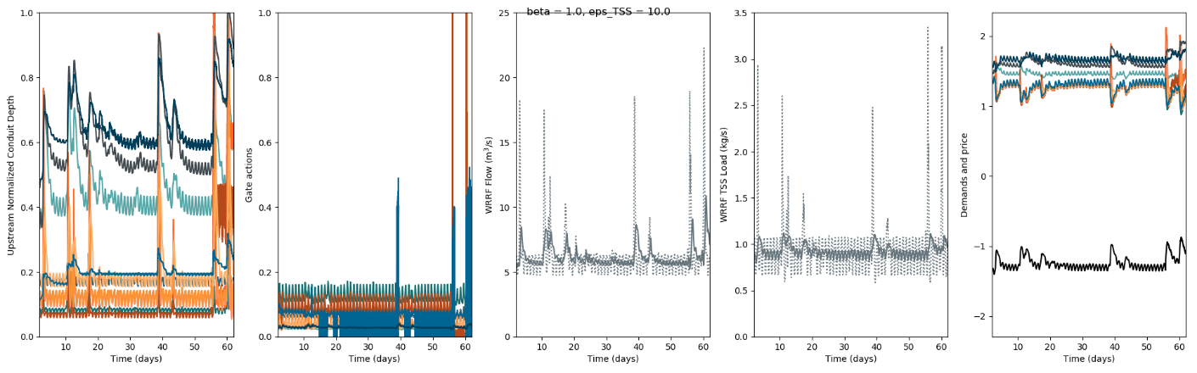
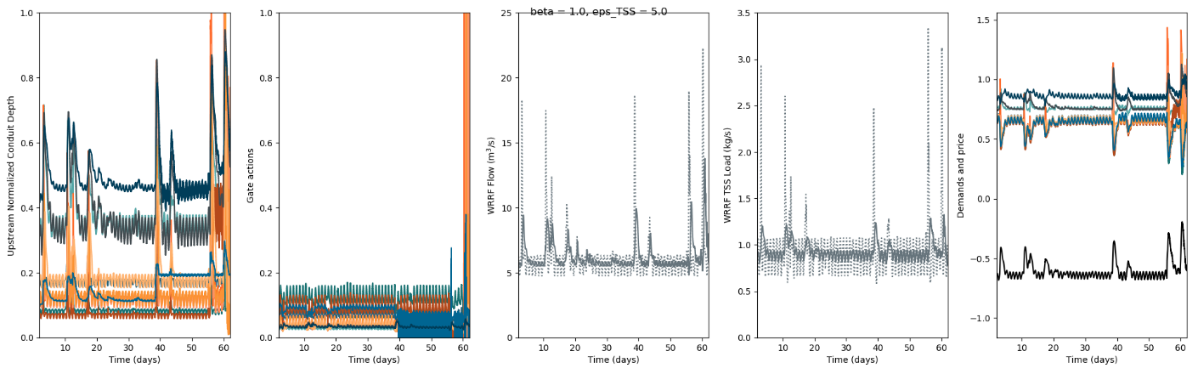
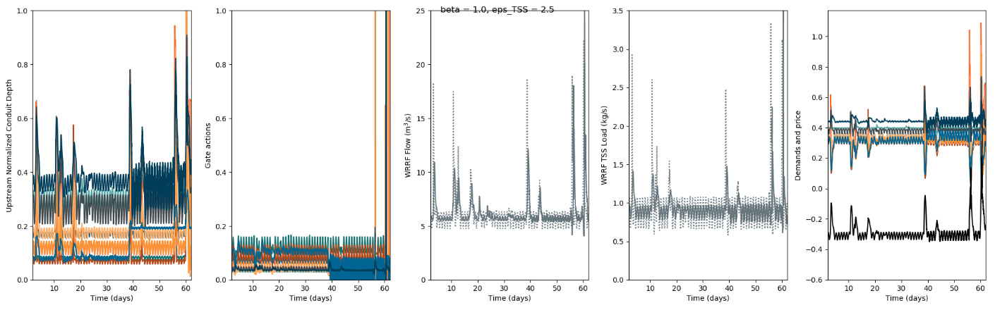
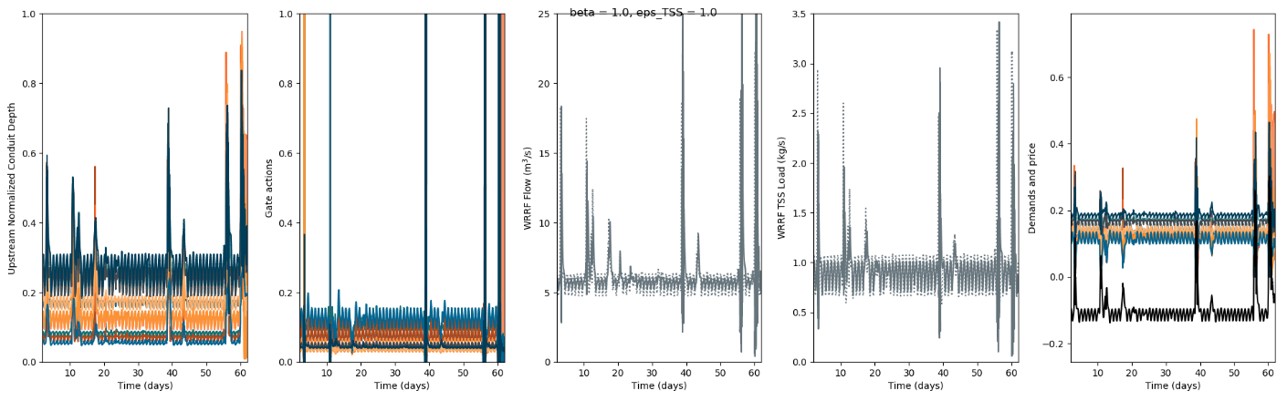
Testing: e(N*Hi)-1/e(N)-1 >= Cbar
test_TSS_6
N = 5
eps_t = 10
eps_t = 5
eps_t = 2.5
eps_t = 1

Slide 8
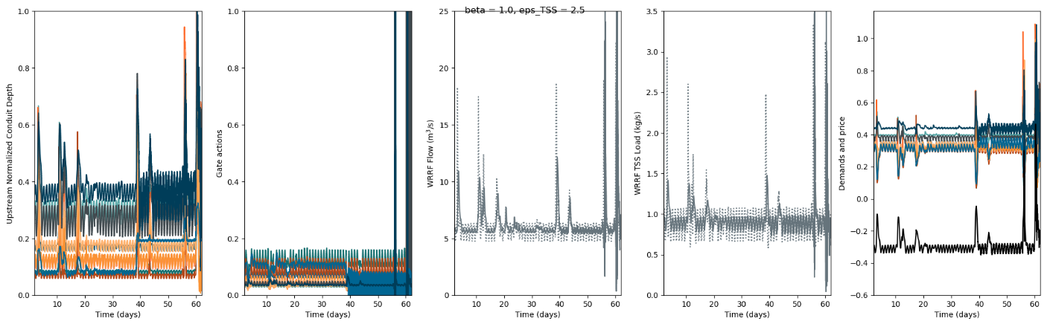
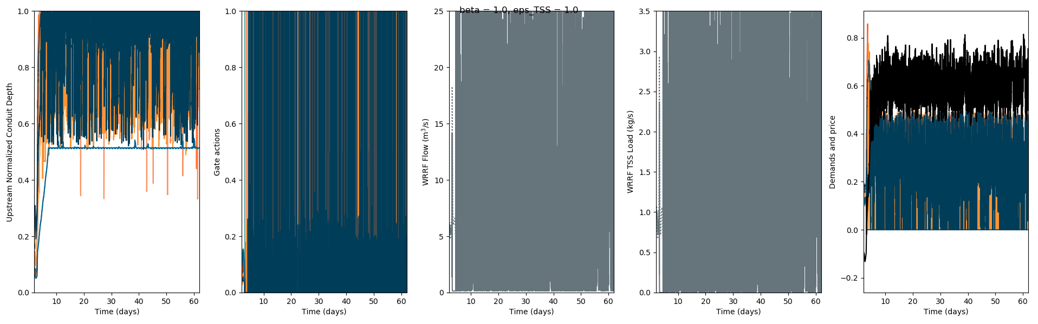
Testing: e(N*Hi)-1/e(N)-1 >= Cbar
test_TSS_6
N = 100
eps_t = 10
eps_t = 5
eps_t = 2.5
eps_t = 1

Slide 9
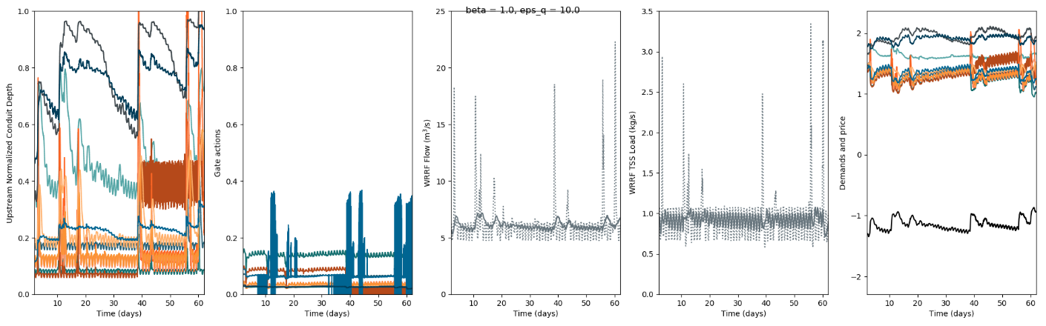
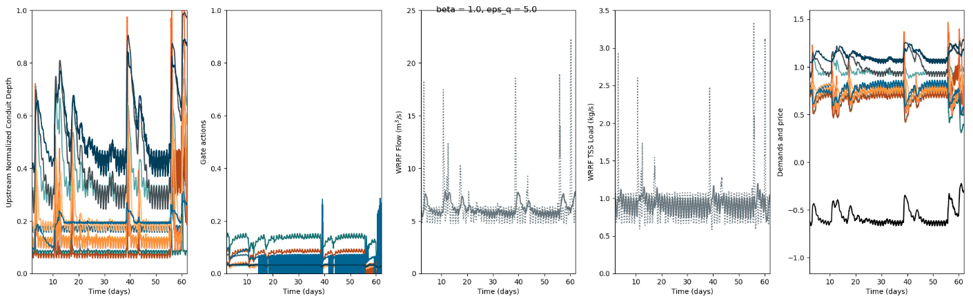
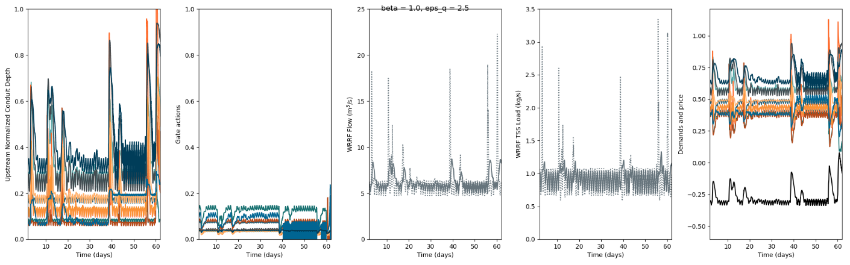
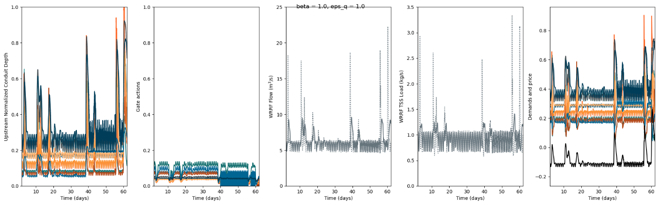
Testing2:
h(Hi) = (e(NHi)-1)/(e(N)-1)
Cbar = sum h(Hi)Hi + betan(Qn-Qn*)
No threshold
Qhati = (Hi-Cbar)/sum(Hj-Cbar)
test_flow_6
N = 1
eps_q = 10
eps_q = 5
eps_q = 2.5
eps_q = 1

Slide 10
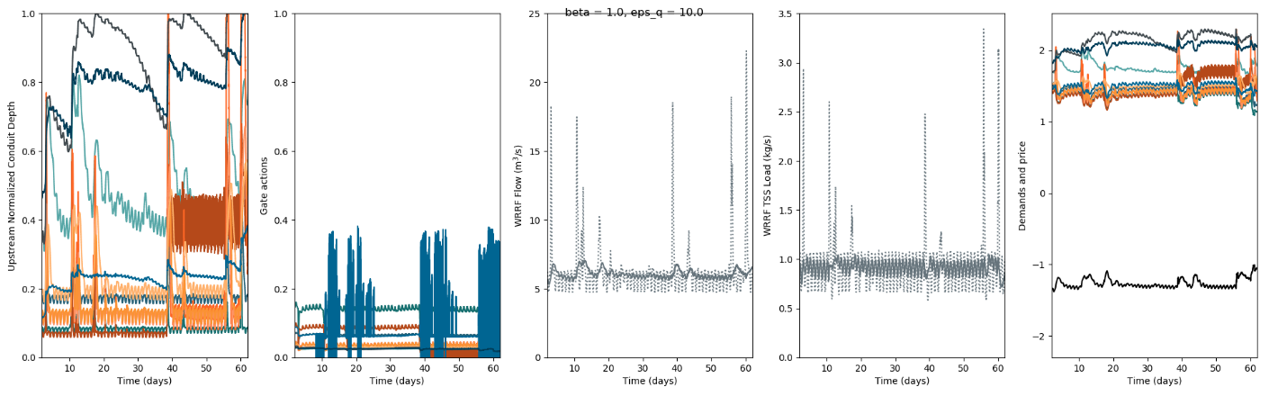
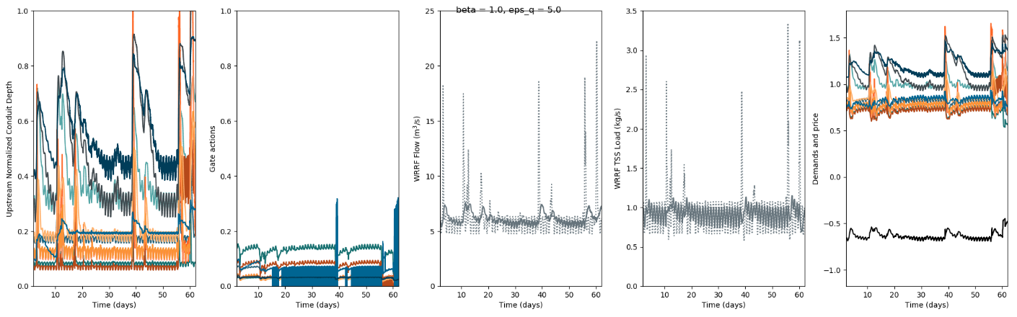
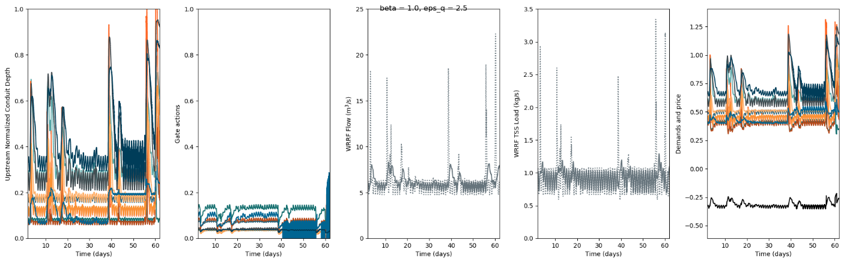
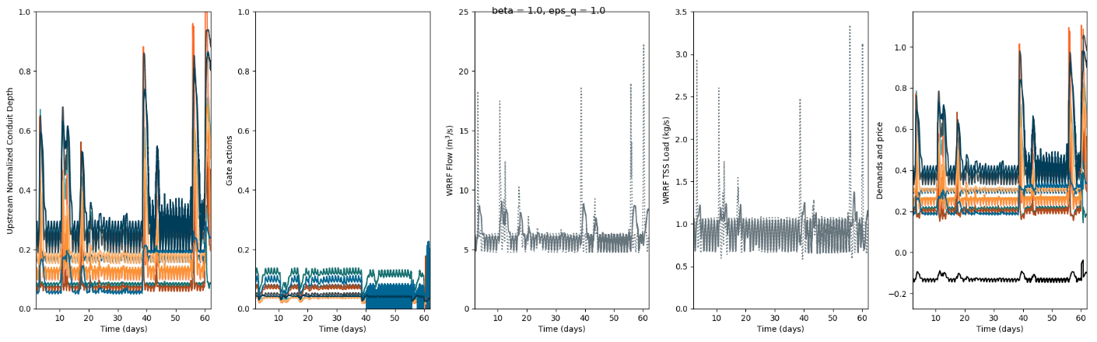
Testing2:
h(Hi) = (e(NHi)-1)/(e(N)-1)
Cbar = sum h(Hi)Hi + betan(Qn-Qn*)
No threshold
Qhati = (Hi-Cbar)/sum(Hj-Cbar)
test_flow_6
N = 100
eps_q = 10
eps_q = 5
eps_q = 2.5
eps_q = 1

Slide 11
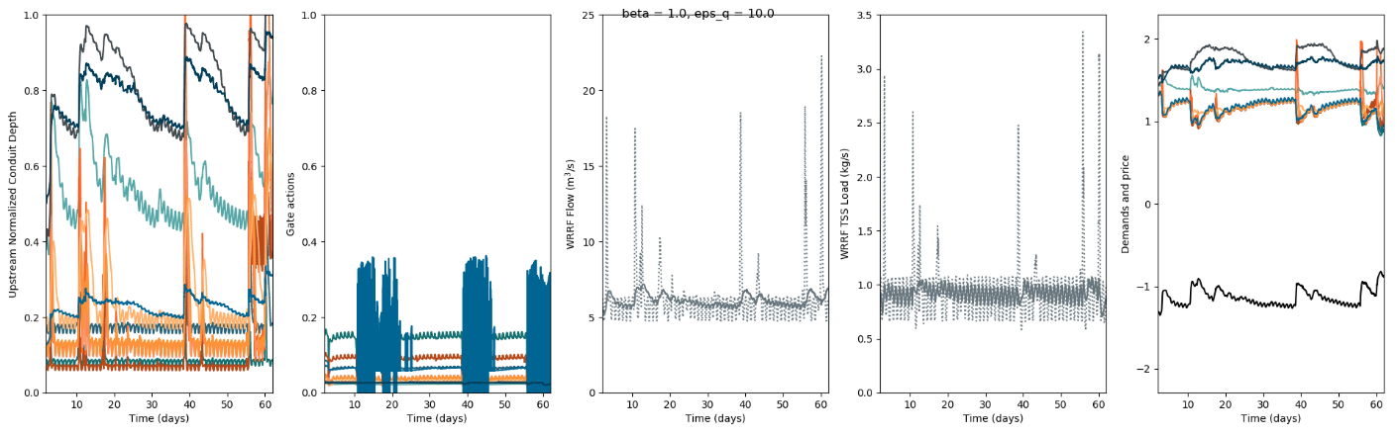
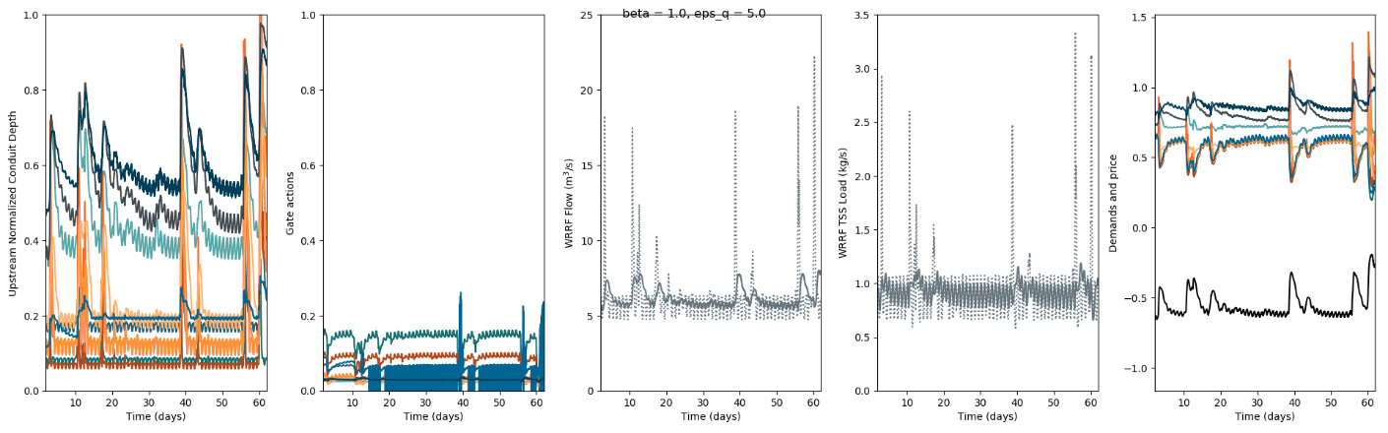
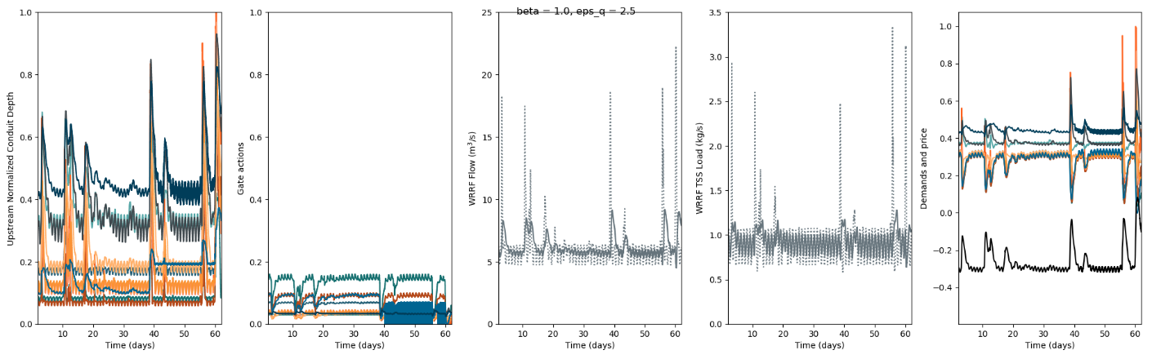
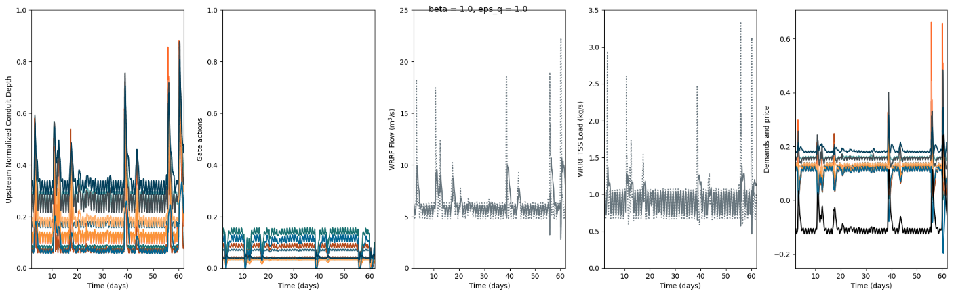
Testing2.2:
h(Hi) = (e(NHi)-1)/(e(N)-1)
Cbar = sum h(Hi)Hi + betan(Qn-Qn*)
No threshold
Qhati = (h(Hi)Hi-Cbar)/sum(h(Hj)Hj-Cbar)
test_flow_6
N = 1
eps_q = 10
eps_q = 5
eps_q = 2.5
eps_q = 1

Slide 12
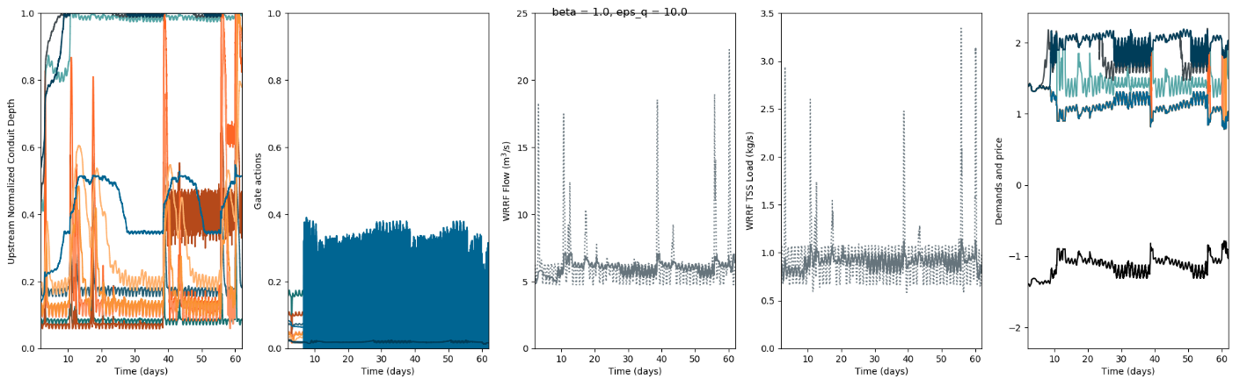
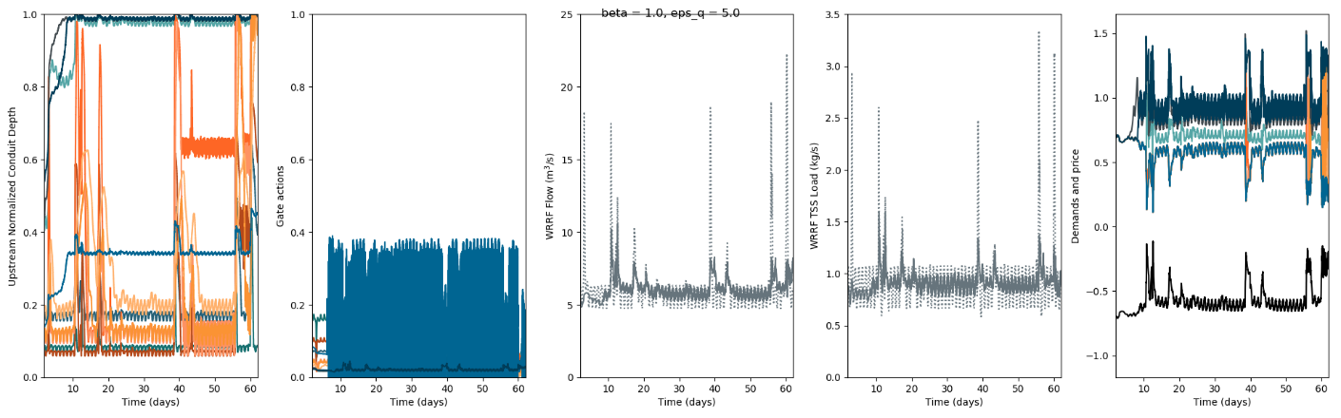
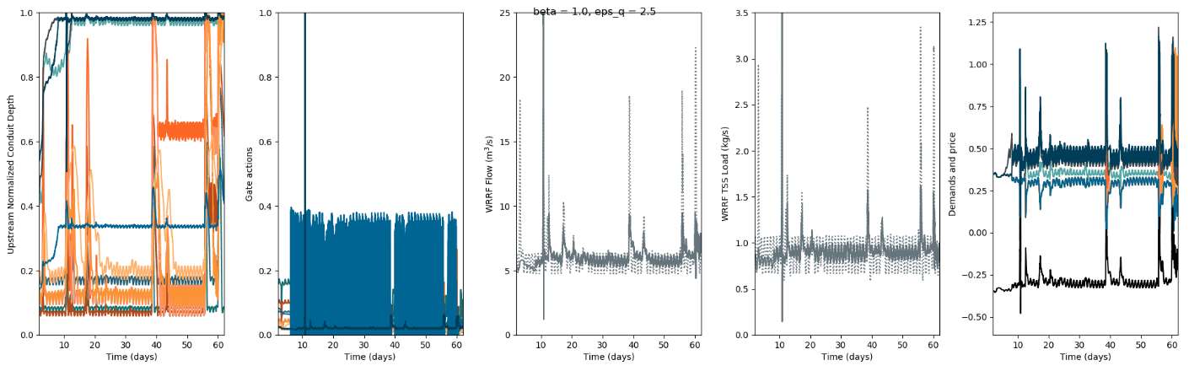
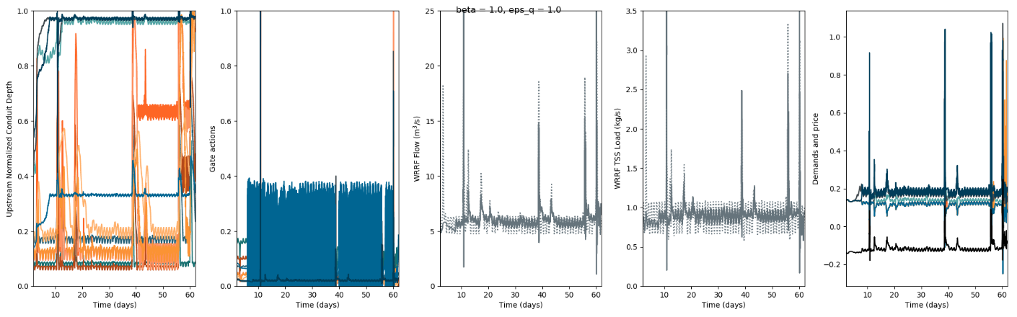
Testing2.2:
h(Hi) = (e(NHi)-1)/(e(N)-1)
Cbar = sum h(Hi)Hi + betan(Qn-Qn*)
No threshold
Qhati = (h(Hi)Hi-Cbar)/sum(h(Hj)Hj-Cbar)
test_flow_6
N = 100
eps_q = 10
eps_q = 5
eps_q = 2.5
eps_q = 1

Slide 13




Testing2.2:
h(Hi) = (e(NHi)-1)/(e(N)-1)
Cbar = sum h(Hi)Hi + betan(Qn-Qn*)
No threshold
Qhati = (max(h(Hi)Hi-Cbar,0.))/sum(max(h(Hj)Hj-Cbar,0.))
test_flow_6
N = 0.001
eps_q = 10
eps_q = 5
eps_q = 2.5
eps_q = 1

Slide 14

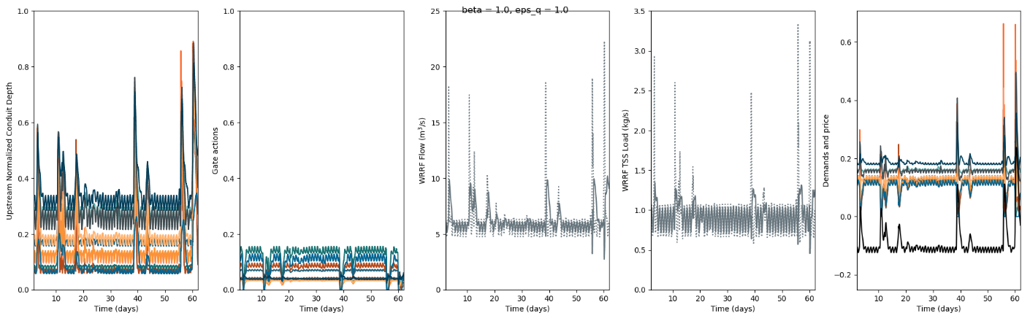
Testing2.2:
h(Hi) = (e(NHi)-1)/(e(N)-1)
Cbar = sum h(Hi)Hi + betan(Qn-Qn*)
No threshold
Qhati = (max(h(Hi)Hi-Cbar,0.))/sum(max(h(Hj)Hj-Cbar,0.))
test_flow_6
N = 1
eps_q = 10
eps_q = 5
eps_q = 2.5
eps_q = 1

Slide 15
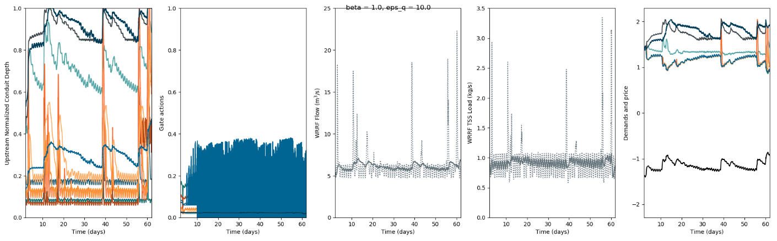
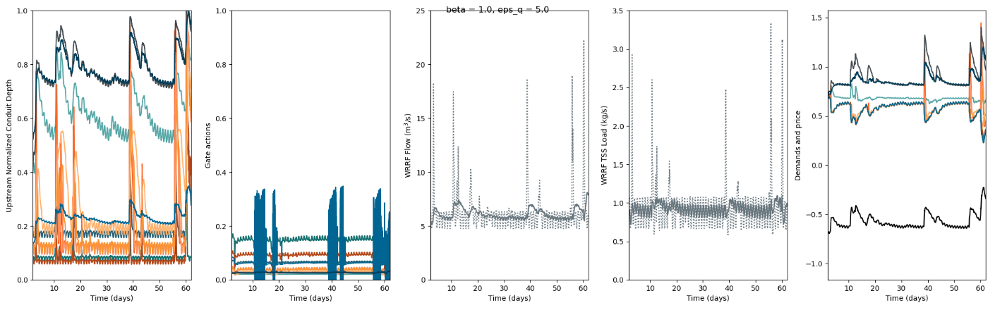
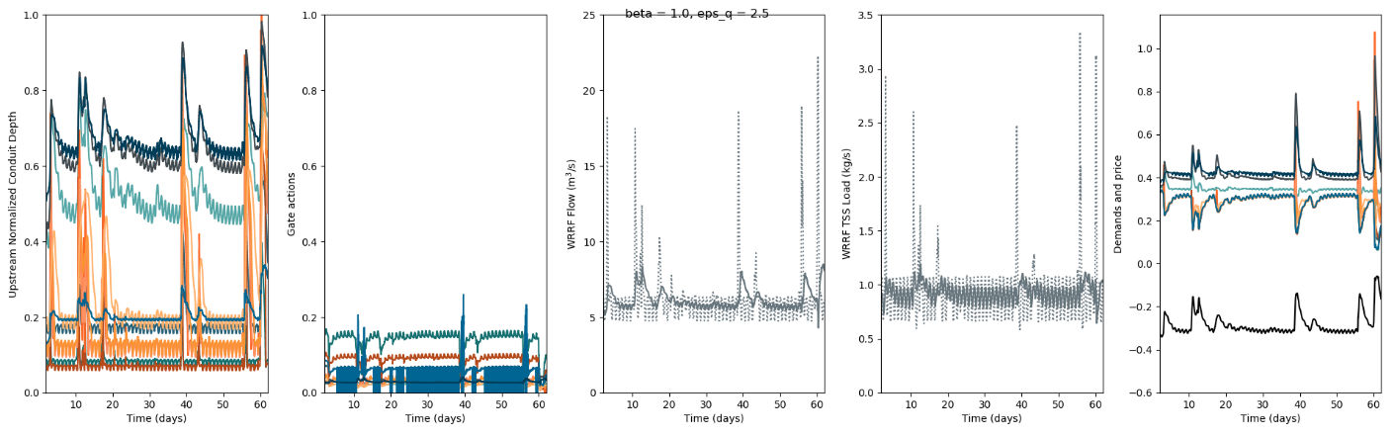
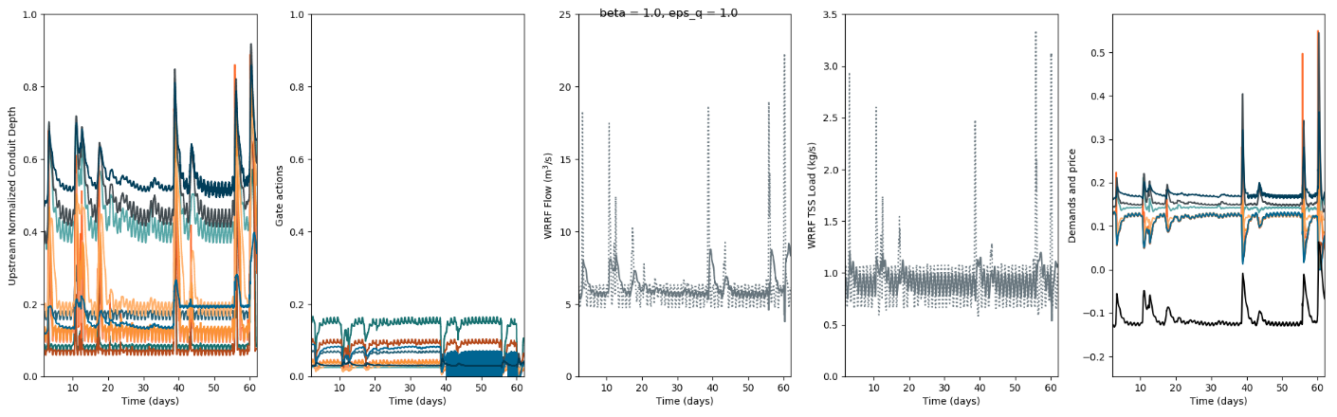
Testing2.2:
h(Hi) = (e(NHi)-1)/(e(N)-1)
Cbar = sum h(Hi)Hi + betan(Qn-Qn*)
No threshold
Qhati = (max(h(Hi)Hi-Cbar,0.))/sum(max(h(Hj)Hj-Cbar,0.))
test_flow_6
N = 5
eps_q = 10
eps_q = 5
eps_q = 2.5
eps_q = 1

Slide 16
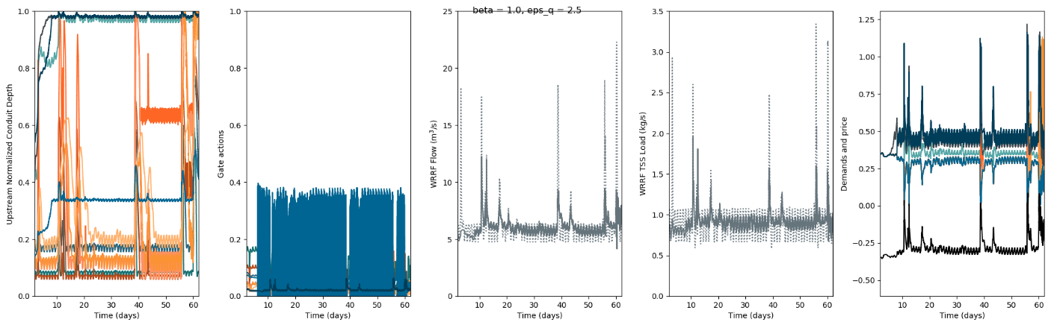
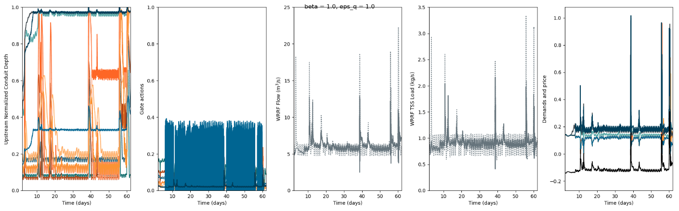
Testing2.2:
h(Hi) = (e(NHi)-1)/(e(N)-1)
Cbar = sum h(Hi)Hi + betan(Qn-Qn*)
No threshold
Qhati = (max(h(Hi)Hi-Cbar,0.))/sum(max(h(Hj)Hj-Cbar,0.))
test_flow_6
N = 100
eps_q = 10
eps_q = 5
eps_q = 2.5
eps_q = 1

Slide 17


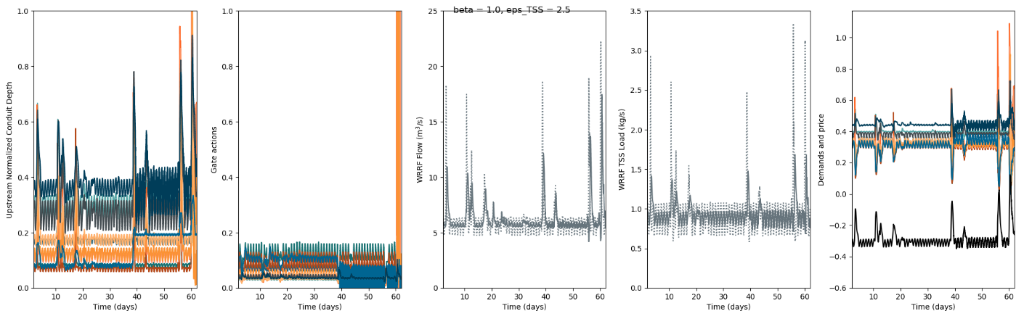
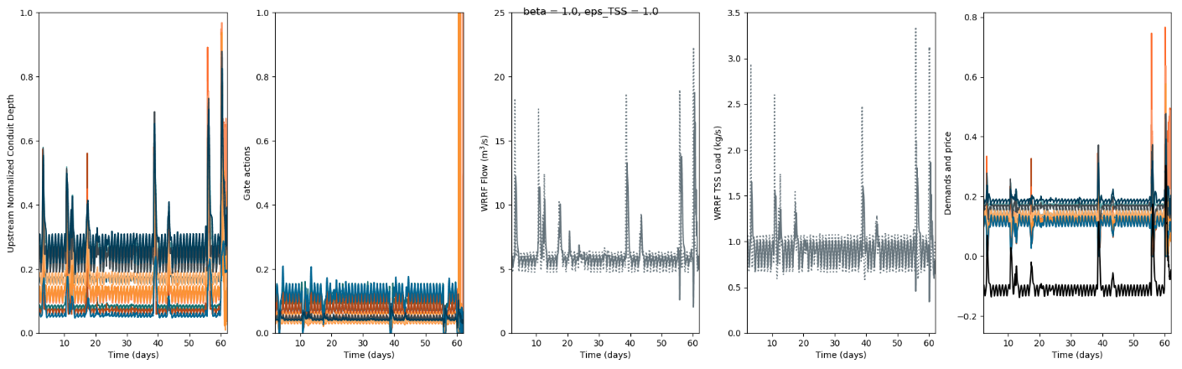
Testing2.2:
h(Hi) = (e(NHi)-1)/(e(N)-1)
Cbar = sum h(Hi)Hi + betan(Qn-Qn*)
No threshold
Qhati = (max(h(Hi)Hi-Cbar,0.))/sum(max(h(Hj)Hj-Cbar,0.))
test_TSS_6
N = 0.001
eps_q = 10
eps_q = 5
eps_q = 2.5
eps_q = 1

Slide 18
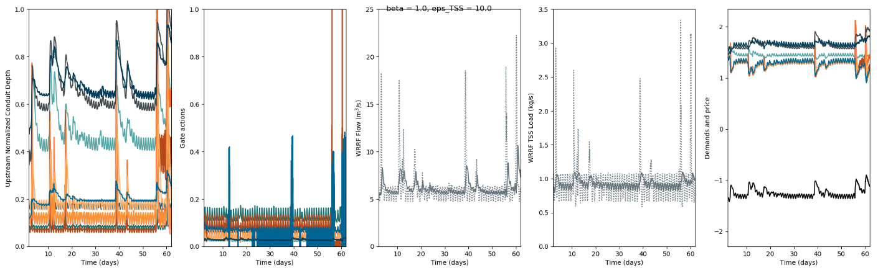
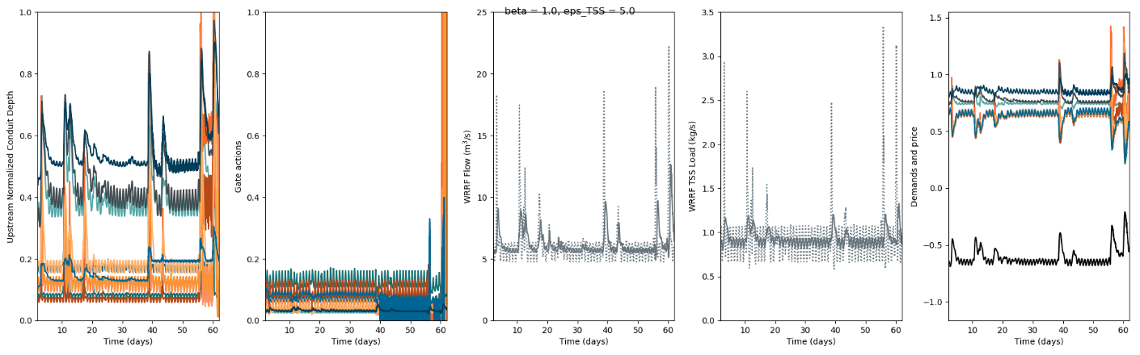
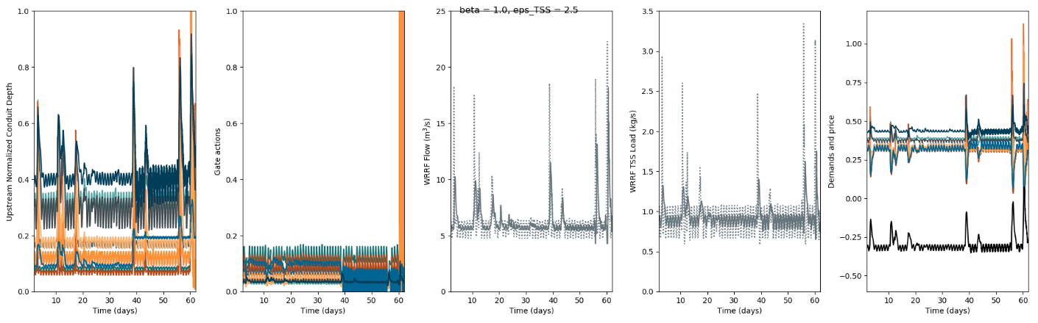
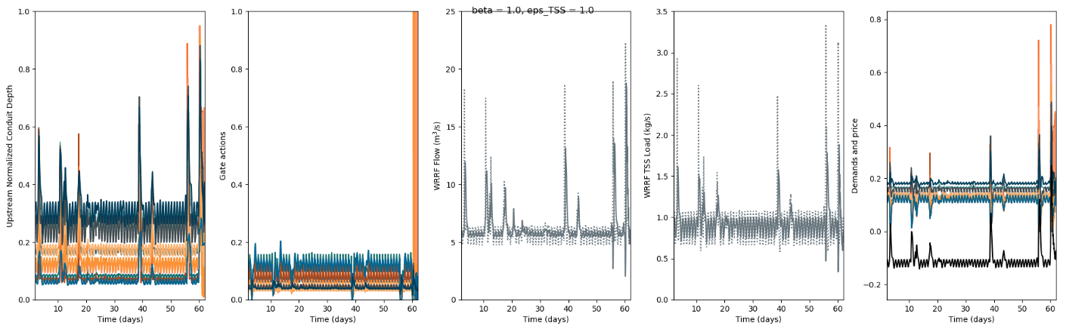
Testing2.2:
h(Hi) = (e(NHi)-1)/(e(N)-1)
Cbar = sum h(Hi)Hi + betan(Qn-Qn*)
No threshold
Qhati = (max(h(Hi)Hi-Cbar,0.))/sum(max(h(Hj)Hj-Cbar,0.))
test_TSS_6
N = 1
eps_q = 10
eps_q = 5
eps_q = 2.5
eps_q = 1

Slide 19
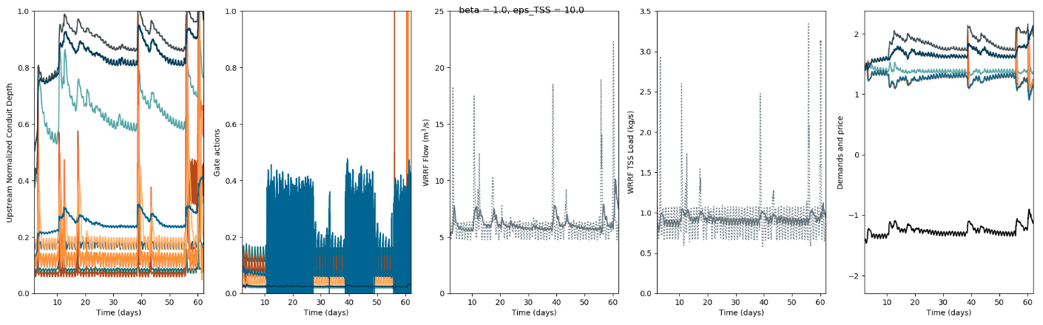
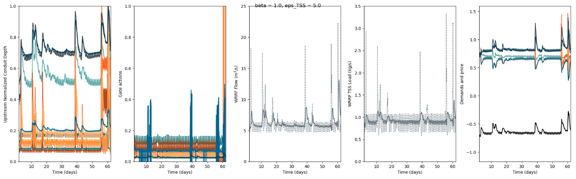


Testing2.2:
h(Hi) = (e(NHi)-1)/(e(N)-1)
Cbar = sum h(Hi)Hi + betan(Qn-Qn*)
No threshold
Qhati = (max(h(Hi)Hi-Cbar,0.))/sum(max(h(Hj)Hj-Cbar,0.))
test_TSS_6
N = 5
eps_q = 10
eps_q = 5
eps_q = 2.5
eps_q = 1

Slide 20




Testing2.2:
h(Hi) = (e(NHi)-1)/(e(N)-1)
Cbar = sum h(Hi)Hi + betan(Qn-Qn*)
No threshold
Qhati = (max(h(Hi)Hi-Cbar,0.))/sum(max(h(Hj)Hj-Cbar,0.))
test_TSS_6
N = 100
eps_q = 10
eps_q = 5
eps_q = 2.5
eps_q = 1

Slide 21




Testing2.2:
h(Hi) = (e(NHi)-1)/(e(N)-1)
Cbar = sum h(Hi)Hi + betan(Qn-Qn*)
No threshold
Qhati = (max(h(Hi)Hi-Cbar,0.))/sum(max(h(Hj)Hj-Cbar,0.))
test_both_6
N = 1
eps_q = 10, eps_t = 10
eps_q = 10, eps_t = 1
eps_q = 1, eps_t = 10
eps_q = 1, eps_t = 1

Slide 22




Testing2.2:
h(Hi) = (e(NHi)-1)/(e(N)-1)
Cbar = sum h(Hi)Hi + betan(Qn-Qn*)
No threshold
Qhati = (max(h(Hi)Hi-Cbar,0.))/sum(max(h(Hj)Hj-Cbar,0.))
test_both_6
N = 10
eps_q = 10, eps_t = 10
eps_q = 10, eps_t = 1
eps_q = 1, eps_t = 10
eps_q = 1, eps_t = 1

Slide 23




Testing2.3:
h(Hi) = (e(NHi)-1)/(e(N)-1)
Cbar = sum h(Hi)Hi + betan(Qn-Qn*)
No threshold
Qhati = h(Hi)/sum(h(Hj))
test_flow_6
N = 1
eps_q = 10
eps_q = 5
eps_q = 2.5
eps_q = 1

Slide 24




Testing2.3:
h(Hi) = (e(NHi)-1)/(e(N)-1)
Cbar = sum h(Hi)Hi + betan(Qn-Qn*)
No threshold
Qhati = h(Hi)/sum(h(Hj))
test_flow_6
N = 2
eps_q = 10
eps_q = 5
eps_q = 2.5
eps_q = 1

Slide 25




Testing2.4:
h(Hi) = (e(NHi)-1)/(e(N)-1)
Cbar = sum h(Hi)Hi + betan(Qn-Qn*)
No threshold
Qhati = (h(Hi)Hi)/sum(h(Hj)Hj)
test_flow_6
N = 1
eps_q = 10
eps_q = 5
eps_q = 2.5
eps_q = 1

Slide 26




Testing2.4:
h(Hi) = (e(NHi)-1)/(e(N)-1)
Cbar = sum h(Hi)Hi + betan(Qn-Qn*)
No threshold
Qhati = (h(Hi)Hi)/sum(h(Hj)Hj)
test_flow_6
N = 100
eps_q = 10
eps_q = 5
eps_q = 2.5
eps_q = 1

